Slide 1
The ASA Difference
PRESENTER

Slide 2
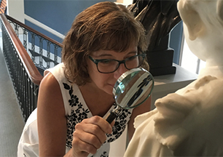
When it comes to valuing an asset, there is no room for error.

Slide 3
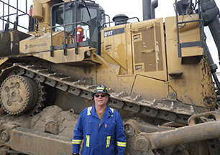
Especially for:
Insurance Needs
Asset Transfers
Bankruptcy
Litigation & Divorce Matters
Financial Reporting
Expert Witness Testimony

Slide 4
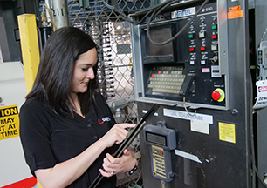
Value matters, and so does the professional hired to make the value determination.

Slide 5
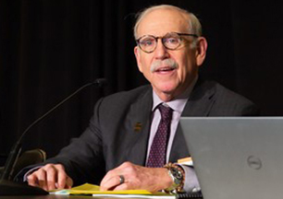
A qualified expert’s experience and education are the factors that can make all the difference.

Slide 6
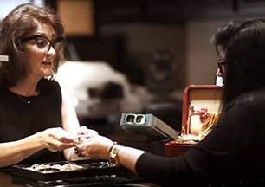
For peace of mind that you have hired the most highly qualified, ethical and experienced professional, always look for the ASA accreditation.

Slide 7
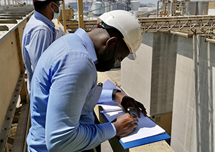
The Accredited Senior Appraiser (ASA) is the most stringent and respected accreditation in the appraisal profession.

Slide 8
ASAs are required to:
Successfully complete 100 hours of valuation education, AND four three-hour exams;
Take an ethics course and pass a test on a set of appraisal standards called USPAP;
Submit a valuation report and pass a peer review process regarding it;
Demonstrate 10,000 hours of valuation experience;
Complete 100 hours of continuing education and professional activities and reaccredit every five years; plus
Meet additional advanced specialized criteria for certification.

Slide 9
ASA is the oldest and only major appraisal organization representing all appraisal specialists.

Slide 10
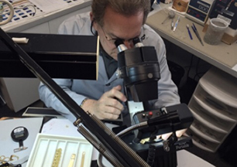
ASA is devoted to providing the highest possible standards in all areas of ethics, professionalism, education and designation.

Slide 11
Don’t risk your appraisal being inaccurate. Hire an ASA accredited appraiser.
Headshot
Name and credentials
Company name
CONTACT ME
for your next appraisal.
(555) 555-5555
www.reallygreatsite.com

